Slide 1


Unpaired t-test
Used when comparing two or more unrelated groups of samples which have undergone the same experiment
The two sample sets are normally distributed
Welch-Correction (when no assumption of equal variance)

Slide 2
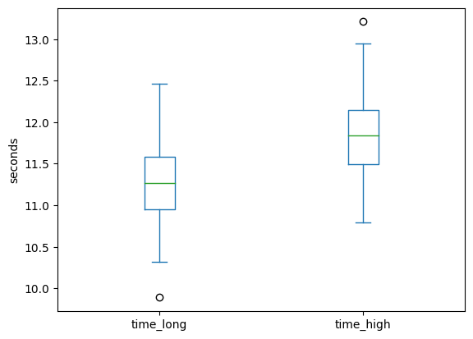
Unpaired t-test - Example
“ Are atheletes usually competing in long jump or high jump respectively faster when performing a 100m dash?”
Notebook - Long vs. High Jump

Slide 3
Notebook conclusion
The (unpaired) t-test assumes normality but seems like a very straightforward way to test for equal means
For me it is a bit unclear if there is really a use case for a non-”Welch corrected” unpaired t-test

